Slide 1
Data Analysis Essentials
Cornerstone Project
Road Accident Data Analysis(India)
Presented by
N.V.Nanda Kishore(25B11CS644)
P.Lakshmanudu (25B11CS774)
B.Harshini(25B11CSA80)
D.Sai Vyshnavi(25B11CS246)
Y.Ram Prasad(25B11CSA47)
Guide: Mr. K. Ashok Teja, Assistant Professor, CSE Dept.
Department of Computer Science and Engineering

Slide 2
Problem Statement
Road accidents in India result in significant loss of life and property due to factors such as road conditions, weather, driver behavior, and traffic violations. This project analyzes road accident data to identify the key factors influencing accident severity and to discover patterns that can support safer roads and informed decision-making.

Slide 3
Objectives
Analyze road accident data across different states and districts in India.
Identify the impact of weather, road conditions, and driver-related factors on accident severity.
Examine the relationship between vehicle type, speed, and accident outcomes.
Visualize accident trends using graphs and statistical analysis.
Generate insights that can support road safety awareness and policy decisions.

Slide 4
DATASET DETAILS
Dataset Information | Key Features
Source: Ministry of Road Transport and Highways (MoRTH) | • Date & Time
Dataset: India Road Accidents Dataset | • State & District
Records: 240 | • Road Type & Road Surface
Attributes: 25 | • Weather & Lighting
Format: CSV | • Vehicle Type
 | • Driver Age Group & Gender
 | • Speed Limit & Estimated Speed
 | • Alcohol Involvement
 | • Helmet/Seatbelt Usage
 | • Severity, Fatalities & Injuries
 | • Primary Cause
 | • Latitude & Longitude

Slide 5
TECH STACK
Programming Language
Python
Python is selected because it provides powerful libraries for data processing, analysis, and visualization.
Libraries Used
Pandas
Data loading and manipulation
Handling structured datasets
Data exploration
NumPy
Numerical operations
Array processing

Slide 6
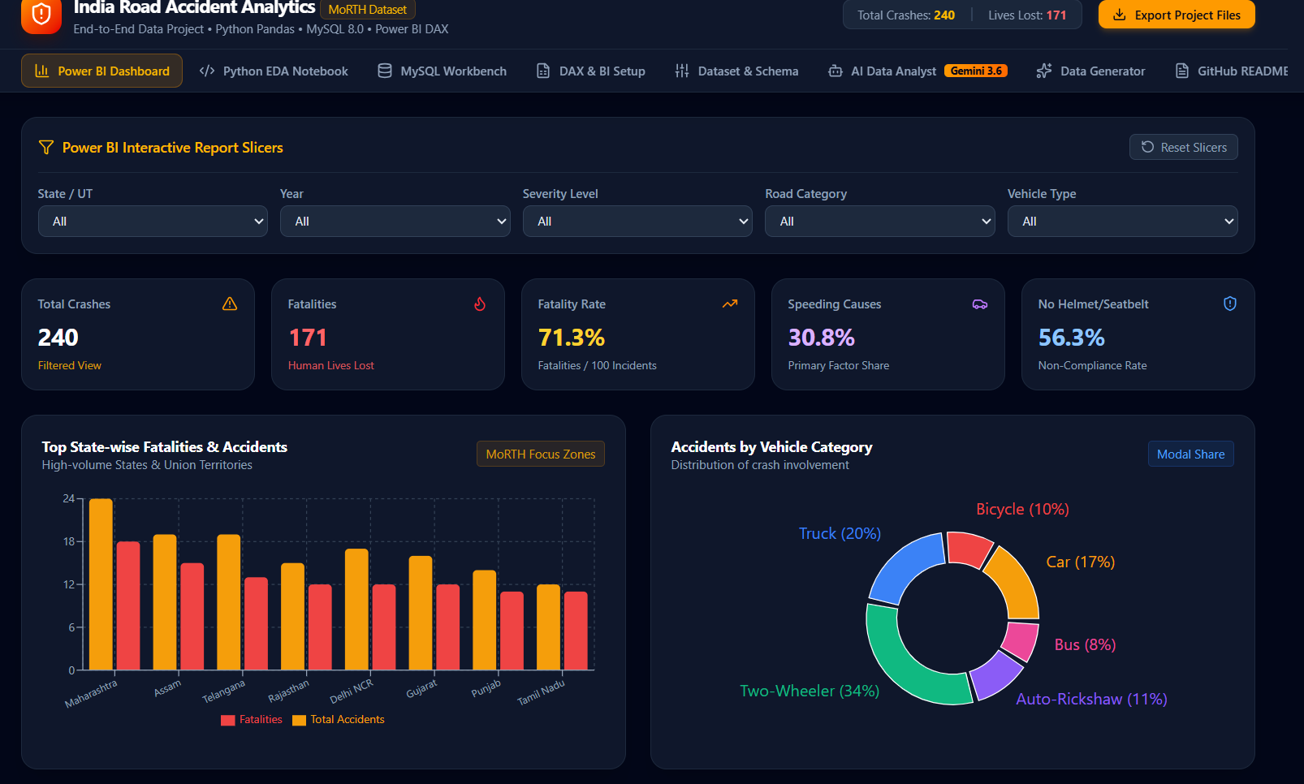
Matplotlib
Creating basic data visualizations
Seaborn
Statistical visualization
Creating attractive graphs for analysis
Development Environment
Google Colab
Used for:
Purpose
Data Loading
Data Cleaning
Data Analysis
Data Visualization

Slide 7
IMPLEMENTATION PLAN
Project Workflow
Load Dataset
↓
Data Cleaning
↓
Data Preprocessing
↓
Exploratory Data Analysis
↓
Data Visualization
↓
Conclusion

Slide 8
WORK COMPLETED SO FAR
Imported required Python libraries.
Loaded and explored the road accident dataset.
Performed data cleaning and preprocessing.
Conducted exploratory data analysis (EDA).
Generated statistical summaries and visualizations.
Developed an interactive dashboard to visualize accident trends and key performance indicators (KPIs).
Recorded initial observations and findings.

Slide 9
CONCLUSION
• Analyzed road accident data across different regions.
• Identified key factors affecting accident severity.
• Studied the impact of weather, road conditions, speed, and driver-related factors.
• Performed data cleaning, preprocessing, and exploratory data analysis.
• Created visualizations to understand accident trends and patterns.
• Developed an interactive dashboard to present key insights.
• The analysis can support road safety awareness and informed decision-making.

Slide 10
Thank You

